Slide 1
Q4 Operating & Revenue Review
Revenue, service mix and delivery reliability · fictional figures, USD thousands
FICTIONAL NEXT-PERIOD DEMONSTRATION · NO CUSTOMER RESULTS
Notes:
Fictional Q4 refresh copied from the Q3 demonstration. Values are authored sample inputs; no customer outcomes or achieved ROI are asserted.

Slide 2
Q4 Revenue Grew but Missed Plan
All numbers shown are fictional sample figures supplied for demonstration. No customer names, testimonials, or achieved ROI claims are included.
$1,150k
Q4 revenue
Up $30k (+2.7%) from Q3; fictional sample.
−4.2%
Versus Q4 plan
$50k below the $1,200k plan; no causal claim.
94%
On-time completion
Up 1 point from Q3; 1 point below target.
Notes:
Fictional Q4 scorecard. Revenue 1150 versus plan 1200 (USD thousands): minus 50, or minus 4.2% rounded. Revenue rose 30 from Q3, or 2.7% rounded. On-time completion is 94%, one percentage point above Q3 and one below the 95% target.

Slide 3
Q4 Revenue Grew $30k, $50k Below Plan
REVENUE PERFORMANCE · USD THOUSANDS (FICTIONAL SAMPLE)
Data: Supplied by the presenter
Review the gap before setting the next forecast.
Notes:
Authored fictional next-period data, USD thousands: Q2 1010, Q3 1120, Q4 1150, Q4 plan 1200. The spreadsheet preview showed eight changes before Replace chart data. This does not explain the variance or represent customer outcomes.

Slide 4
Installation and Maintenance Account for 84.3% of Q4 Revenue
SERVICE-LINE MIX · Q4 USD THOUSANDS (FICTIONAL SAMPLE)
Data: Supplied by the presenter
Review the service mix before setting next-period staffing assumptions.
Notes:
Authored fictional Q4 inputs: Installation 550, Maintenance 420 and Monitoring 180, in USD thousands. Total 1150; shares round to 47.8%, 36.5% and 15.7%. Installation plus maintenance is 970/1150 = 84.3%. Four paste changes were reviewed before replacement. These are demonstration inputs, not customer outcomes or causal evidence.

Slide 5
Q4 On-Time Completion Reached 94%, One Point Below Target
DELIVERY RELIABILITY · ON-TIME COMPLETION (FICTIONAL SAMPLE)
Data: Supplied by the presenter
Test dispatch changes before claiming any improvement in reliability.
Notes:
Fictional sample inputs: Q3 on-time completion 93%, Q4 94%, target 95%. The change is one percentage point, with one point still below target. Four chart changes were reviewed. No observed customer outcome or causal effect is claimed.

Slide 6
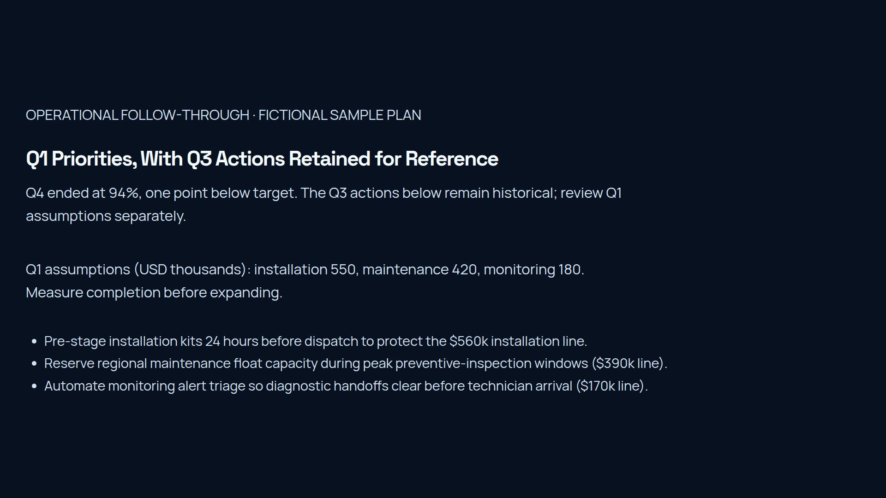
Notes:
Fictional planning example. Q4 completion is 94%, one percentage point below the 95% target. Current Q1 workload assumptions use installation 550, maintenance 420 and monitoring 180 USD thousands. The three older Q3 action bullets remain historical reference, with their original 560/390/170 figures; they are not the updated plan or evidence of achieved improvement.
Planning detail moved from the visible paragraph to reduce density: Q1 planning assumptions use the fictional Q4 mix: installation $550k, maintenance $420k and monitoring $180k. Trial dispatch preparation and monitoring triage, then measure completion against the 95% target before expanding.

