Slide 1
Q3 Operating & Revenue Review
Revenue trajectory, service-line mix, and on-time completion discipline (USD thousands · fictional sample data)
FICTIONAL SAMPLE FIGURES · QUARTERLY BUSINESS REVIEW
Notes:
Welcome to the Q3 Quarterly Business Review. All figures in this deck are explicitly fictional sample data.

Slide 2
Q3 Beat Revenue Plan While Closing the On-Time Gap
All numbers shown are fictional sample figures supplied for demonstration. No customer names, testimonials, or achieved ROI claims are included.
$1,120k
Q3 Revenue (+3.7% vs. $1,080k Plan; up from $920k Q1 & $1,010k Q2)
93%
Q3 On-Time Completion (up from 89% in Q2; 2 pts below 95% target)
50% / 35% / 15%
Q3 Mix: Installation $560k · Maintenance $390k · Monitoring $170k
Notes:
Summarize Q3 headline performance against plan using the supplied fictional sample numbers.

Slide 3
Q3 Revenue Reached $1,120k, Exceeding the $1,080k Plan by $40k
Notes:
Walk through sequential revenue growth from Q1 920k to Q2 1010k and Q3 1120k against the 1080k Q3 plan.

Slide 4
Installation ($560k) and Maintenance ($390k) Drive 85% of Q3 Revenue
Notes:
Break down Q3 revenue of $1,120k across Installation ($560k), Maintenance ($390k), and Monitoring ($170k).

Slide 5
On-Time Completion Improved 4 Points to 93% Against a 95% Target
Notes:
Compare Q2 89% and Q3 93% on-time completion against the 95% operational target.

Slide 6
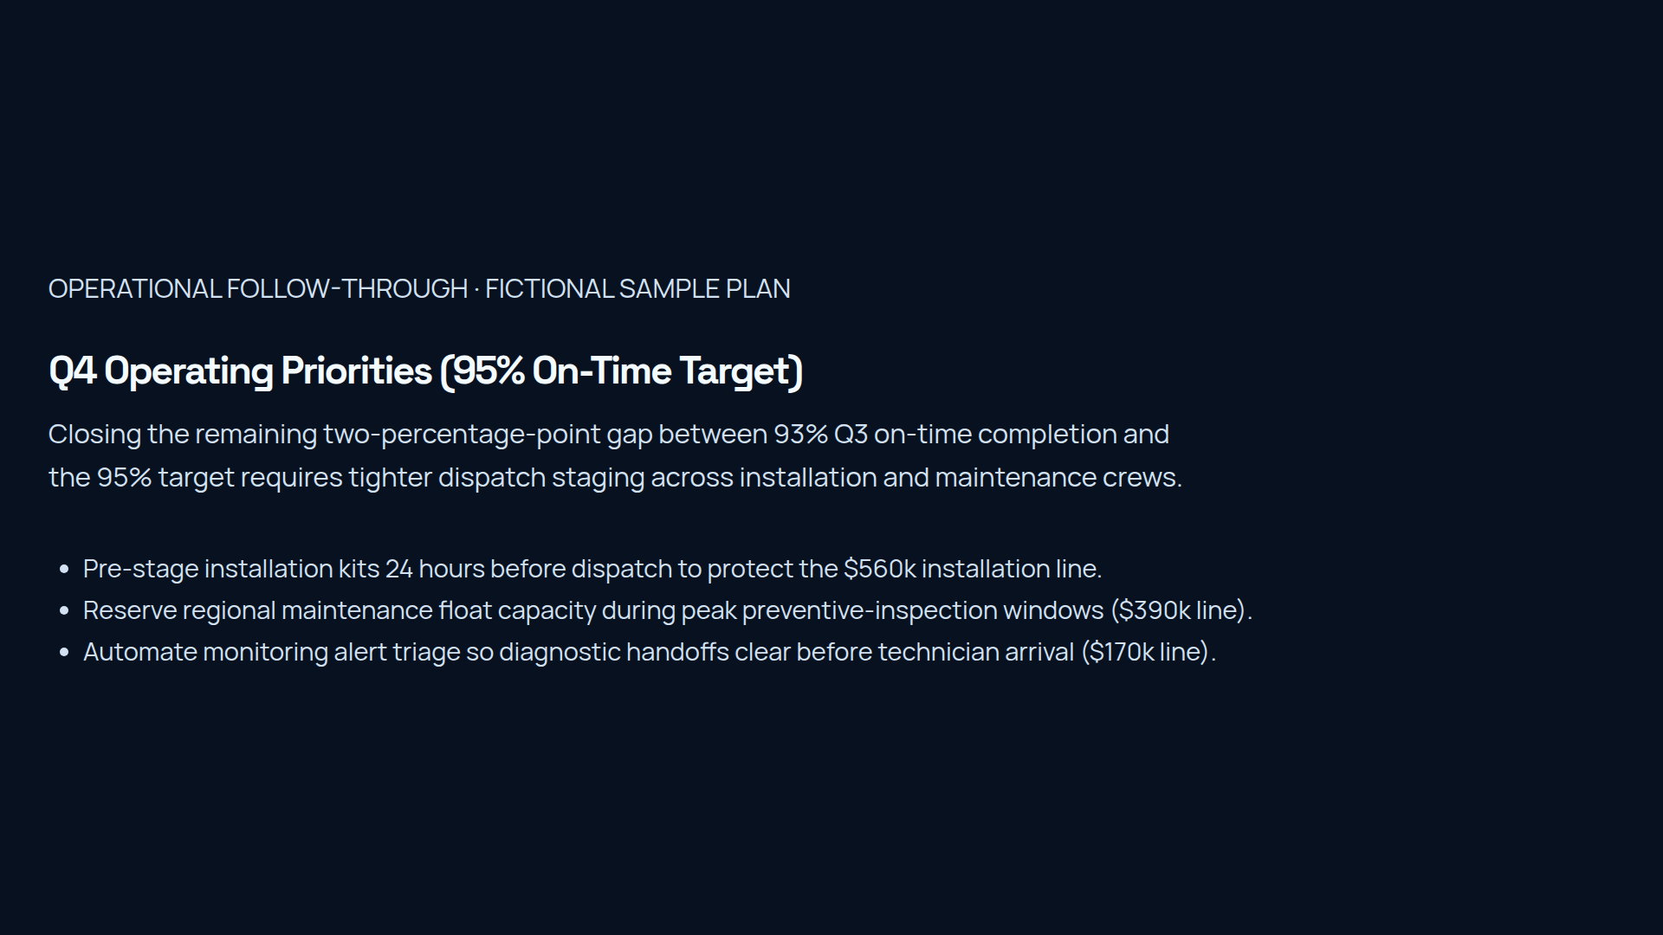
Notes:
Outline the three operational actions required to close the remaining 2-point gap to the 95% on-time target.

