Slide 1
Lockout / Tagout & Zero-Energy Verification
Mandatory field safety sequence for commercial rooftop and switchgear maintenance technicians
EMPLOYEE TRAINING MODULE · FICTIONAL SAMPLE CURRICULUM
Notes:
Introduce the mandatory field safety training curriculum for lockout/tagout and zero-energy verification.

Slide 2
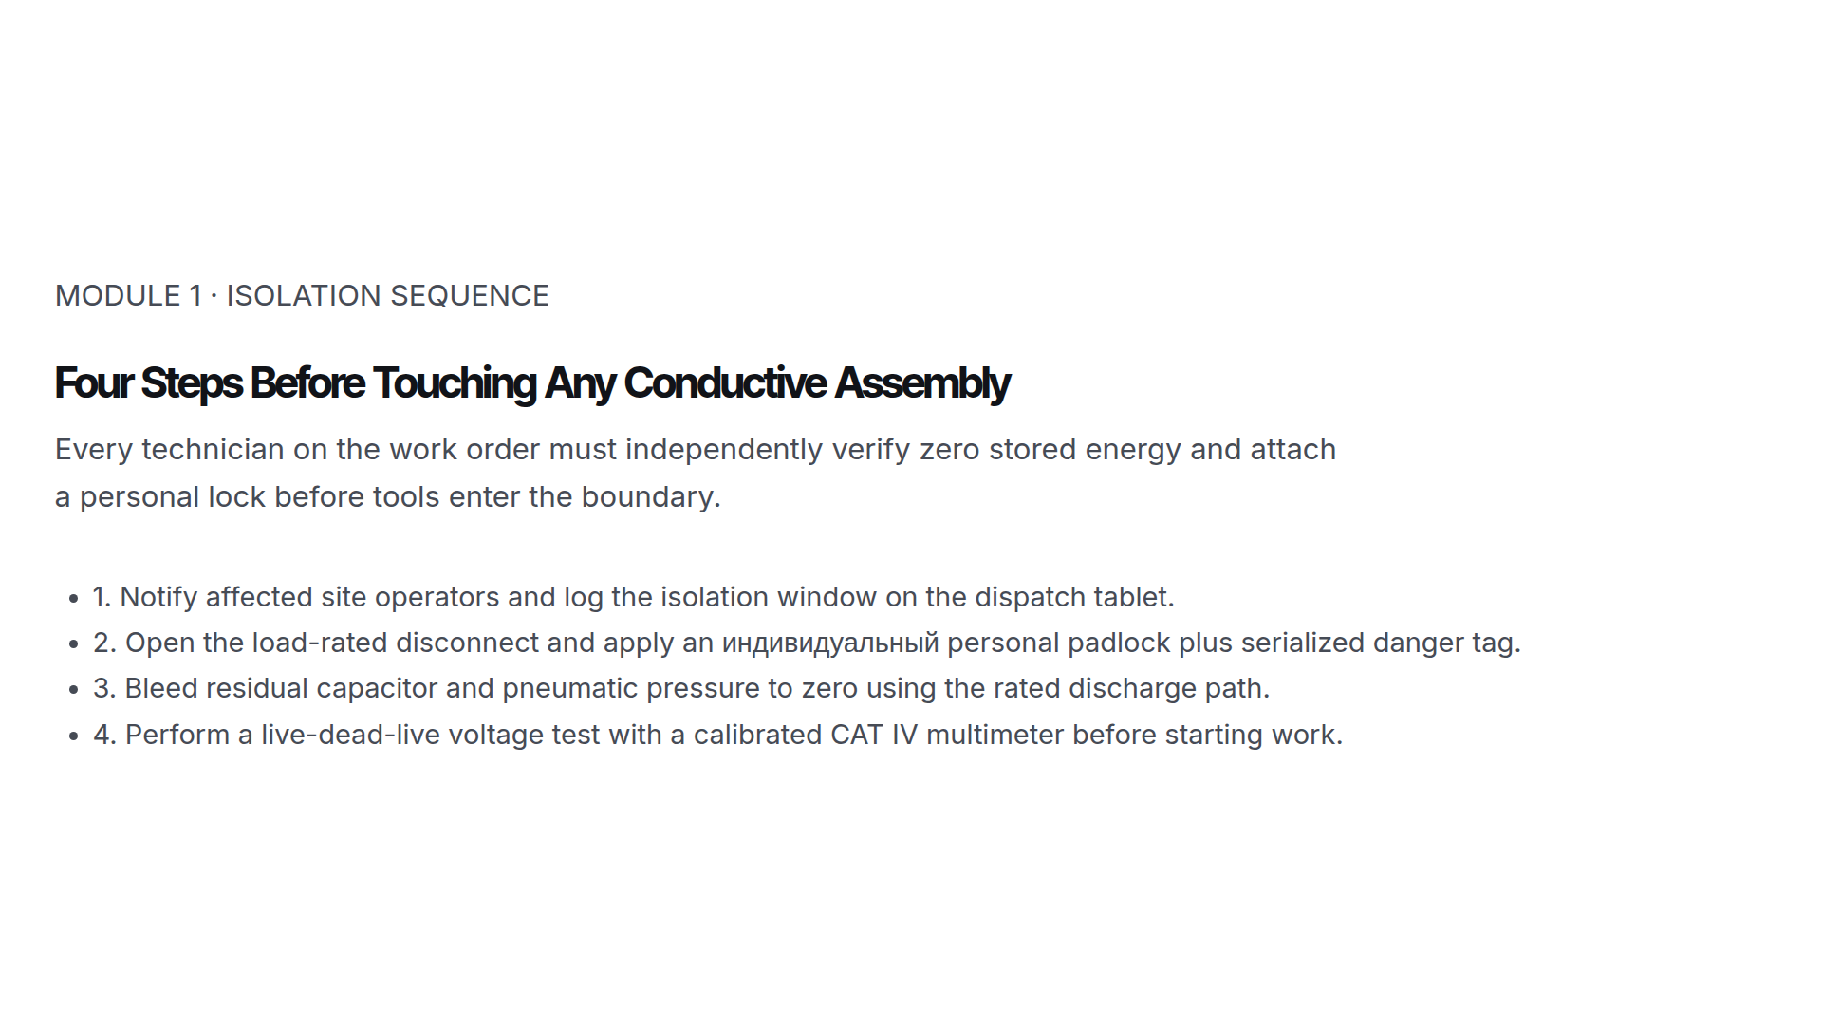
Notes:
Review the four non-negotiable isolation steps before opening any energized enclosure.

Slide 3
Three Non-Negotiable Field Safety Standards
1 Lock / Tech
Every crew member attaches their own lock to the group hasp—never rely on a lead’s lock
0 Volts
Live-Dead-Live meter check against a known source before and after testing the isolated bus
100% Sign-Off
All tools cleared, guards replaced, and personnel accounted for prior to re-energization
Notes:
Contrast compliant group lockout against common field shortcuts that cause incidents.

Slide 4
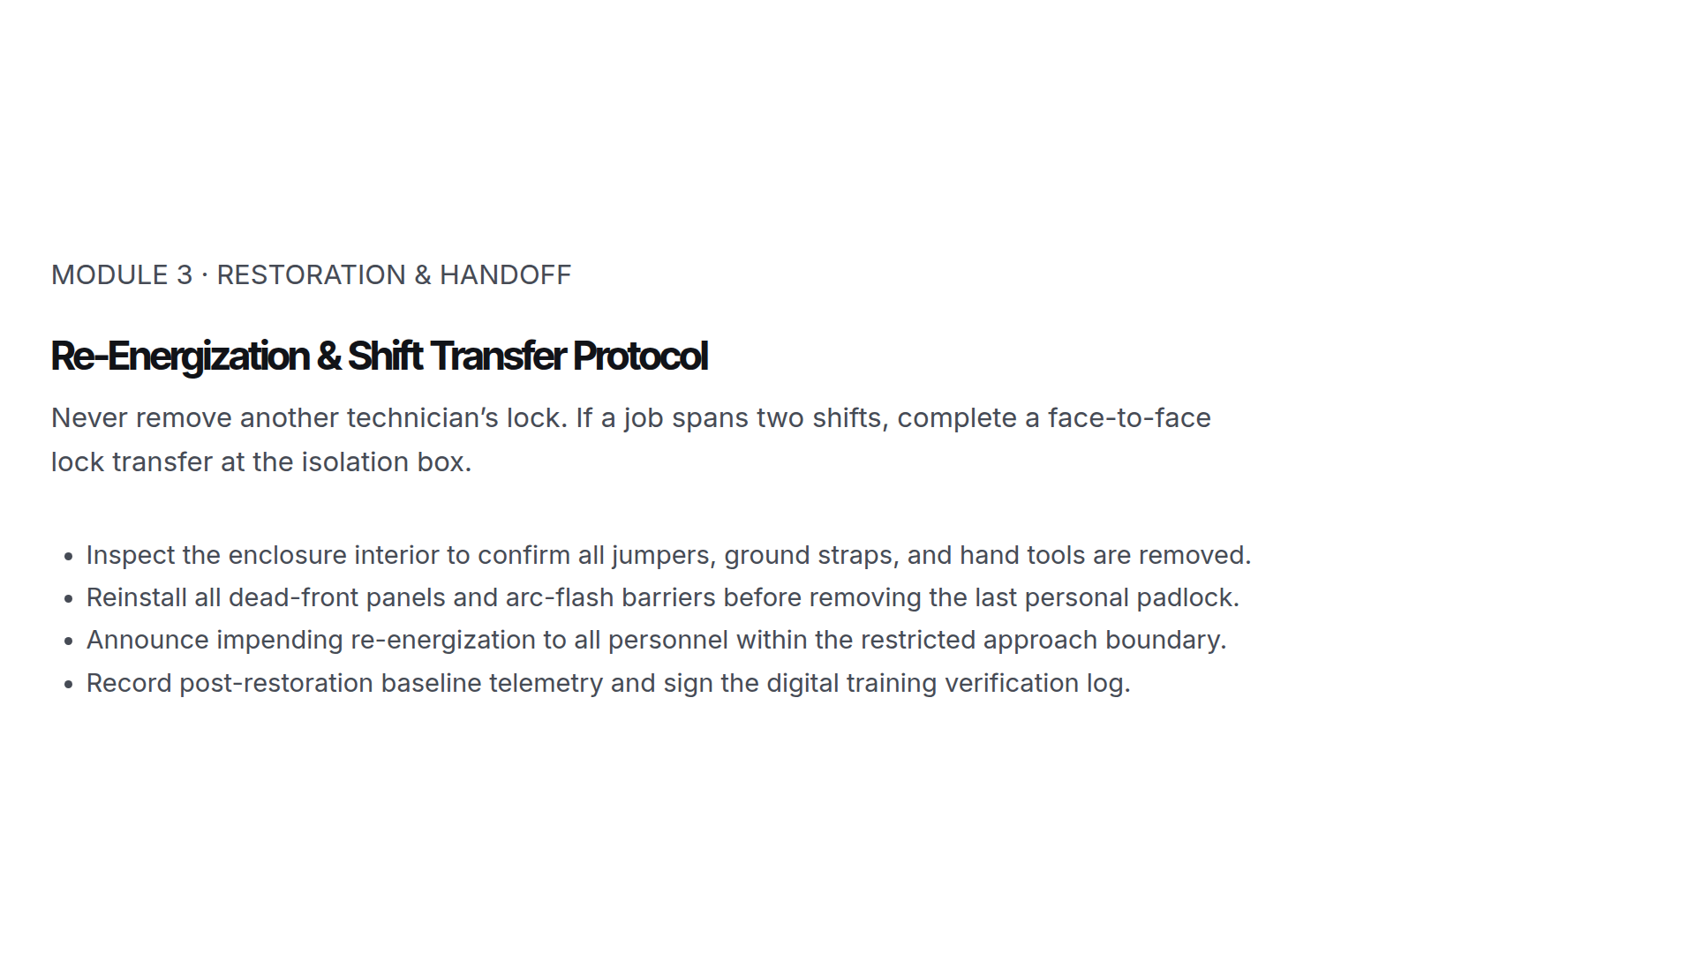
Notes:
Walk through the restoration checklist required before removing locks and restoring power.

