Slide 1

Heat Safety: Protect Those at Greater Risk
Who needs extra protection from heat and why vehicles are never safe.

Slide 2

HEAT SAFETY
Heat Puts Some People at Greater Risk
Know who needs extra protection and why a locked vehicle can become deadly.
Heat can cause illness and can worsen existing health conditions. Everyone is vulnerable, but risk is not shared equally.
[noaa-1]

Slide 3

HIGHER RISK
Three Groups Need Extra Heat Protection
Older adults
People with chronic conditions
Pregnant women
Risk rises with disease, medication use, living alone, or limited mobility.
Extreme heat is associated with adverse birth outcomes, including preterm birth.
A heat wave can trigger more serious health problems than it does for healthy people.
[noaa-1]
[noaa-1]
[noaa-1]

Slide 4

CHILDREN
Young Children Adapt Less Readily to Heat
Infants and young children are particularly vulnerable to heat-related illness and death.
Their bodies are less able to adapt to heat than adult bodies. Infants are specifically included in this higher-risk group.
[noaa-1]

Slide 5

VEHICLE SAFETY
A Locked Car Is Never Safe
""It is NEVER safe to leave a child, disabled person or pet locked in a car, even in the winter.""
- National Weather Service
[noaa-1]

Slide 6

ACT EARLY
The Danger Is Not Limited to Summer
A child can die in 10 minutes inside a car.
Reported child deaths occur as early as April and continue into December in southern states. The source reports 31 children died in hot cars in 2025.
[noaa-1]

Slide 7
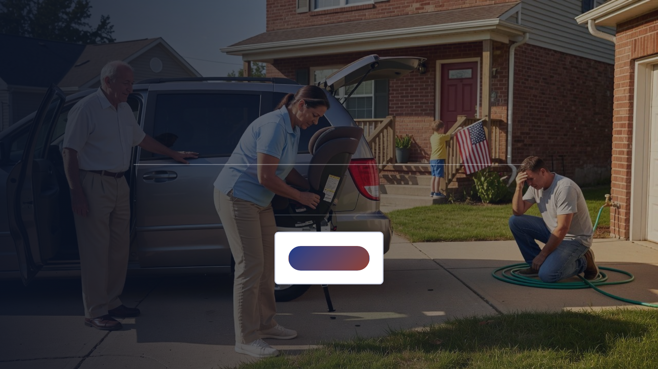
TAKE ACTION
Keep Children and Pets Out of Locked Cars
Review the vehicle safety rule before the next hot day.
Review the rule

Slide 8

References
Heat Safety Resources

