Slide 1
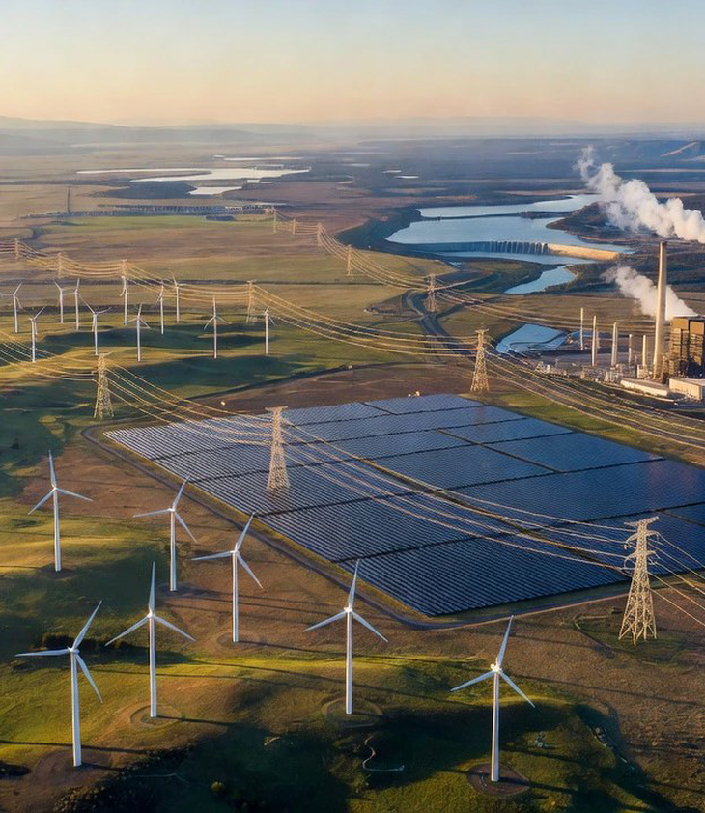
U.S. Electricity: Generation, Capacity and Sales
How power is produced, balanced and sold.

Slide 2
Agenda
01
Generation mix
02
Generation technologies
03
Capacity and grid operations
04
Retail electricity sales
Notes:
This presentation follows electricity from production through grid operation to retail sales. It first explains the generation mix and major technologies, then distinguishes capacity from generation and explains operating strategies, and concludes with the customers and providers involved in electricity sales.

Slide 3
Fossil fuels supplied 58% of utility-scale generation
Data: your brief
Each value is stated in the material supplied for this deck.
Natural gas alone produced about 41% of utility-scale generation.
Notes:
Net utility-scale generation totaled about 4.43 trillion kilowatthours in 2025. Fossil fuels remained the largest broad category, led by natural gas. Nuclear supplied the second-largest individual source, while renewable energy provided nearly one-quarter of utility-scale generation.

Slide 4
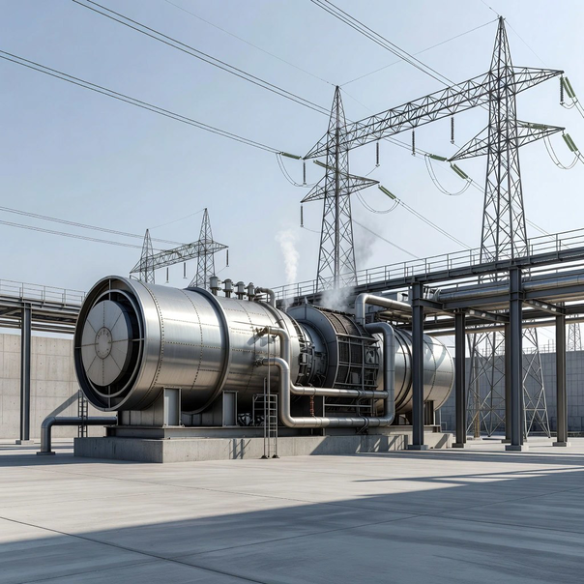
Gas turbines help natural gas follow changing demand
Flexible natural gas.
Natural gas powers steam turbines and gas turbines.
Combined-cycle plants can follow demand changes quickly.
Notes:
Natural gas was the leading U.S. utility-scale electricity source in 2025. It can power both steam turbines and gas turbines. Many natural gas-fired combined-cycle facilities operate as intermediate resources because they have relatively low operating costs and can ramp output quickly as demand changes.

Slide 5
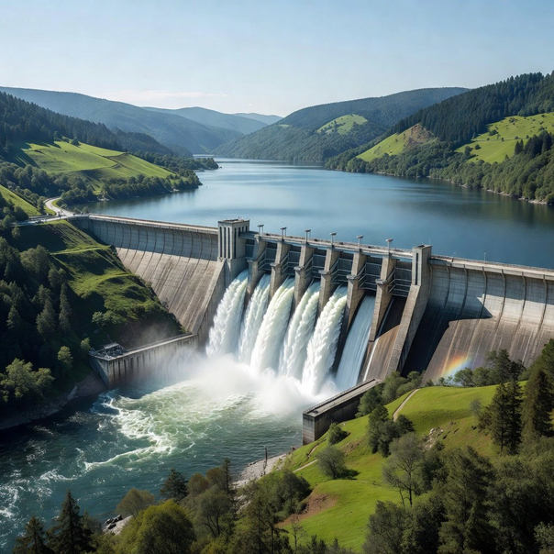
Hydro turbines convert flowing water into electricity
Water turns turbines.
Conventional hydropower provided about 6% of utility-scale generation in 2025.
Output fluctuates with precipitation patterns.
Notes:
Conventional hydropower produced about 6% of total utility-scale generation in 2025 and accounted for about 23% of renewable utility-scale generation. Hydropower uses flowing water to spin a turbine connected to a generator. Many large hydro generators can also be operated as base-load resources.

Slide 6
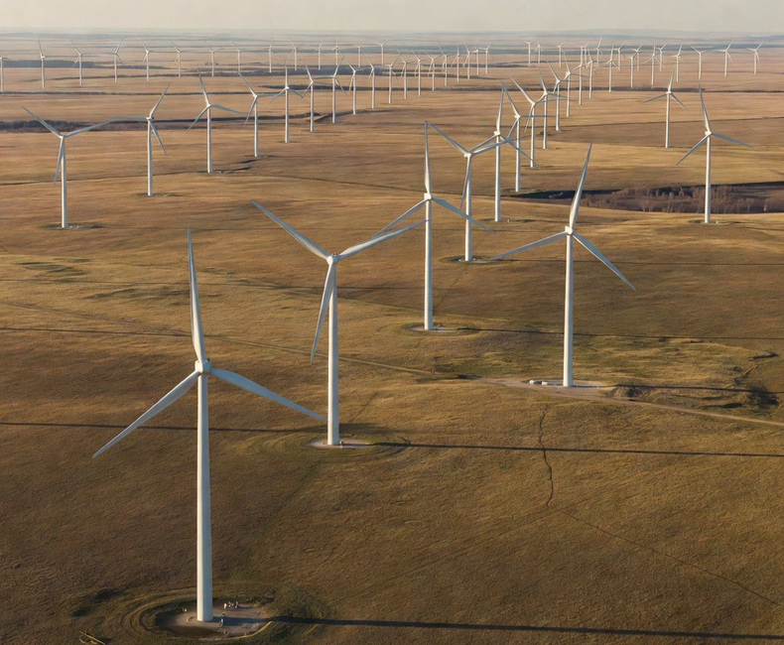
Wind is the largest renewable generation source
Wind converts motion.
Wind supplied about 11% of utility-scale generation in 2025.
Its output depends on available wind resources.
Notes:
Wind was the largest renewable electricity source in 2025, accounting for about 11% of total utility-scale generation and 43% of utility-scale renewable generation. Wind turbines convert wind energy into electricity, but they operate only when the wind resource is available.

Slide 7
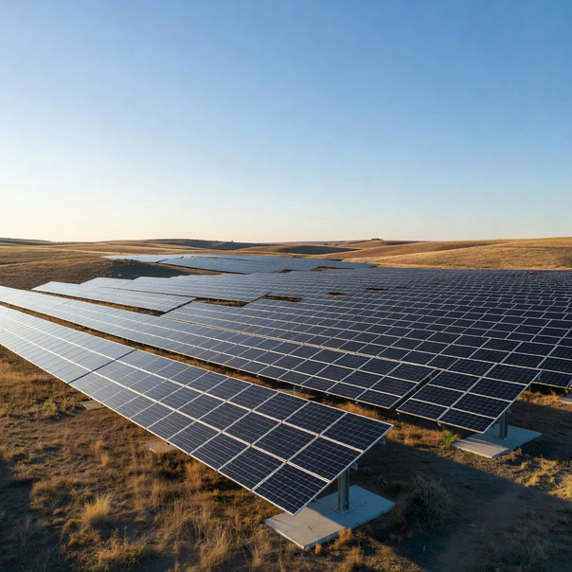
Solar photovoltaics convert sunlight directly into electricity
Direct solar conversion.
Nearly all solar electric generation came from photovoltaic systems.
Small-scale rooftop PV is the leading distributed resource.
Notes:
Solar photovoltaic and solar thermal plants together provided about 7% of total utility-scale electricity in 2025, with nearly all solar electric generation coming from photovoltaic systems. PV cells convert sunlight directly into electricity. Small-scale solar PV added an estimated 93.15 billion kilowatthours in 2025.

Slide 8
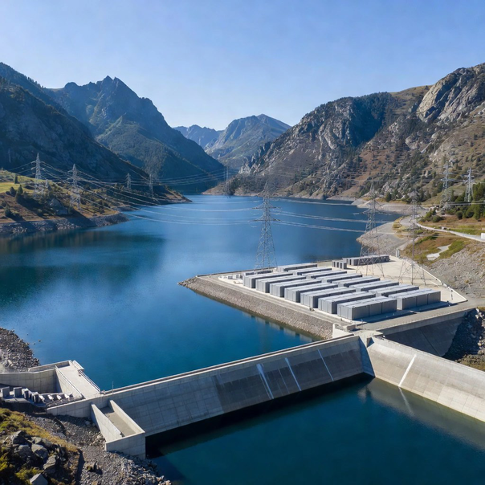
Several minor sources support specialized grid needs
Other grid resources.
Other sources include pumped storage, batteries, hydrogen and purchased steam.
Other gases and sources supplied about 0.2% in 2025.
Notes:
Pumped-storage hydroelectric, non-biogenic municipal solid waste, batteries, hydrogen, purchased steam, sulfur, tire-derived fuel, and other miscellaneous sources are grouped as other sources. Together with other gases, these sources accounted for about 0.2% of U.S. utility-scale electricity generation in 2025. Energy storage generally has negative net generation because it uses more electricity to charge than it generates when discharged.

Slide 9

Capacity enables the grid to balance supply and demand
1
Install capacity.
Plants provide maximum power under specified conditions.
2
Dispatch output.
Operators call on plants as demand changes.
3
Balance instantly.
Supply must meet grid demand every moment.
Notes:
Generation measures electricity produced over time. Capacity is the maximum electric power that a plant can supply at a specific point under specific conditions. Grid operators must call on resources so supply and demand are balanced instantaneously. A plant does not necessarily operate at full capacity every hour.

Slide 10
Generators serve base, intermediate and peak demand
Base load.
Runs nearly continuously for minimum system demand.
Intermediate load.
Varies output to follow demand changes.
Peak load.
Supplies short periods of highest demand.
Notes:
Base-load units tend to run nearly continuously and generally have capacity factors of 70% or higher. Intermediate units vary output to follow changes in demand. Peak-load units serve high-demand periods and tend to have capacity factors below 15%. Operating roles can change as the generation portfolio evolves.

Slide 11
Natural gas holds the largest capacity share
Data: your brief
Each value is stated in the material supplied for this deck.
Total utility-scale capacity reached 1,280,799 MW at year-end.
Notes:
At the end of 2025, total U.S. utility-scale capacity was 1,280,799 MW. Natural gas had the largest capacity share at 40.0%, followed by renewables at 31.5%. Capacity shares differ from generation shares because plants operate at different output levels and at different times.

Slide 12
Residential and commercial customers each accounted for 37% of sales
Data: your brief
Each value is stated in the material supplied for this deck.
Retail sales were about 4,058 billion kWh in 2025.
Notes:
U.S. retail electricity sales totaled about 4,058 billion kWh in 2025. Residential and commercial customers each represented 37% of sales, while industrial customers accounted for 26%. Transportation represented less than 1%. Retail sales include net electricity imports from Canada and Mexico.

Slide 13
Electricity reaches customers through distinct provider models
Full-service providers.
Sell bundled energy and delivery services to end users.
Other providers.
Market electricity or provide delivery-related services.
Notes:
Full-service providers sell bundled electricity energy and delivery services. They may generate electricity themselves, purchase it from other full-service providers, or buy from independent power producers. Other providers primarily include electricity marketers in customer-choice states, while full-service providers deliver the power.

Slide 14
Generation, Capacity, Sales
Use each measure to understand the U.S. electricity system.

