Slide 1
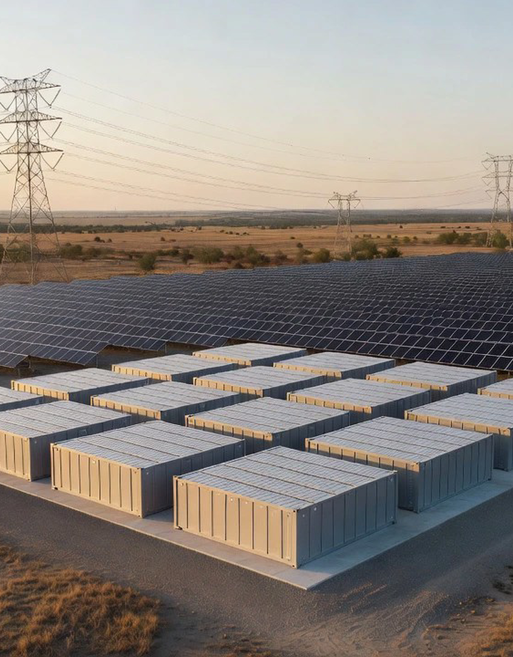
Where 2026 Storage Will Concentrate
A market-prioritization view of planned U.S. solar and battery additions.

Slide 2
Agenda
01
National buildout.
02
Solar concentration.
03
Storage concentration.
04
Recommended sequence.
Notes:
This deck moves from the national buildout to the state-level concentration that should shape the initial market scan. The core finding is that planned 2026 storage additions are heavily concentrated in Texas, with California and Arizona forming the next tier.

Slide 3
The 2026 pipeline makes solar and storage the central buildout
Planned capacity.
86 GW
Record if realized.
Solar share.
51%
Largest planned source.
Battery storage share.
28%
Second-largest planned source.
Wind share.
14%
Third-largest planned source.
Notes:
Developers and operators plan 86 GW of new utility-scale generating capacity in 2026, a record if realized. Solar is the largest component, followed by battery storage and wind. The scale and composition establish why solar-plus-storage markets warrant early attention.

Slide 4
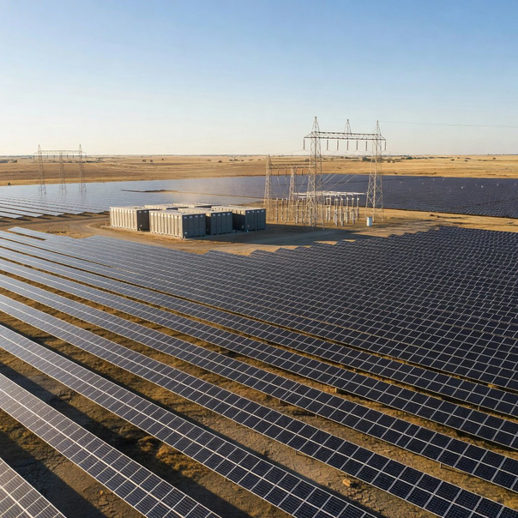
Texas commands the 2026 utility-scale solar pipeline
Solar leader.
Texas accounts for 40% of planned U.S. utility-scale solar additions in 2026.
Start the solar market scan in Texas.
Notes:
Texas alone is planned to receive 40% of new U.S. utility-scale solar capacity in 2026. This is the largest state share by a wide margin and provides the strongest solar-market signal among the four leading states.

Slide 5
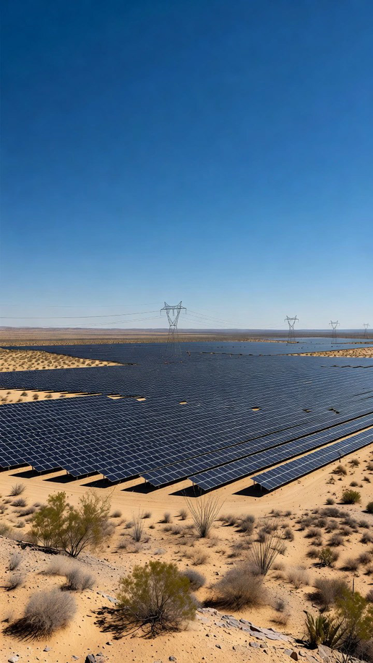
Arizona forms a meaningful second tier in solar additions
Arizona is planned to account for 6% of new U.S. utility-scale solar capacity in 2026.
Include Arizona in the next market-screening wave.
Notes:
Arizona represents 6% of planned 2026 utility-scale solar additions. It is one of four states that collectively account for more than half of the planned national solar buildout.

Slide 6
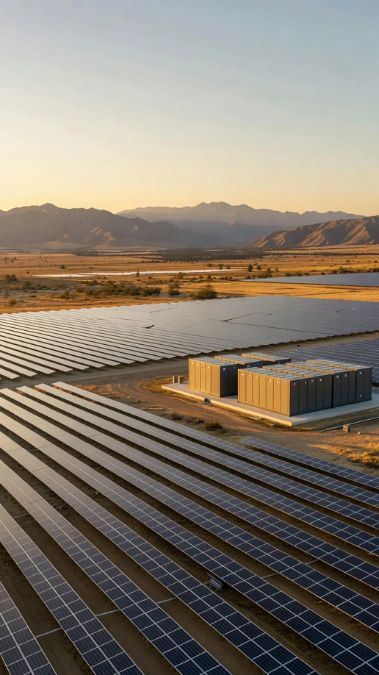
California matches Arizona’s planned solar share
California is planned to receive 6% of new U.S. utility-scale solar capacity in 2026.
Assess California through an integrated solar-and-storage lens.
Notes:
California is also planned to account for 6% of new utility-scale solar capacity in 2026. Its solar position is matched by a larger planned battery-storage market, which strengthens its relevance for integrated solar-and-storage evaluation.

Slide 7
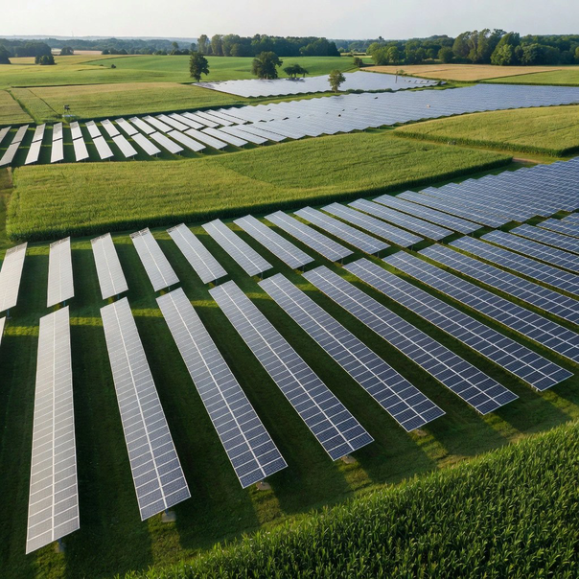
Michigan completes the leading four-state solar cluster
Four-state cluster.
Michigan represents 5% of planned U.S. utility-scale solar capacity additions in 2026.
Use Michigan to complete the initial solar scan.
Notes:
Michigan accounts for 5% of planned U.S. utility-scale solar additions in 2026. Although smaller than Texas, Arizona, and California, it is one of the four states comprising more than half of the national solar pipeline.

Slide 8
Planned battery storage share.
53%
Of 2026 U.S. battery storage is planned in Texas.
24 GW
Planned U.S. storage additions.
80%
Located across three states.
15 GW
Added during 2025.
Notes:
Battery storage is more geographically concentrated than the overall solar pipeline. Texas is planned to account for 53% of new U.S. utility-scale battery storage capacity in 2026, making it the clear first-priority state.

Slide 9
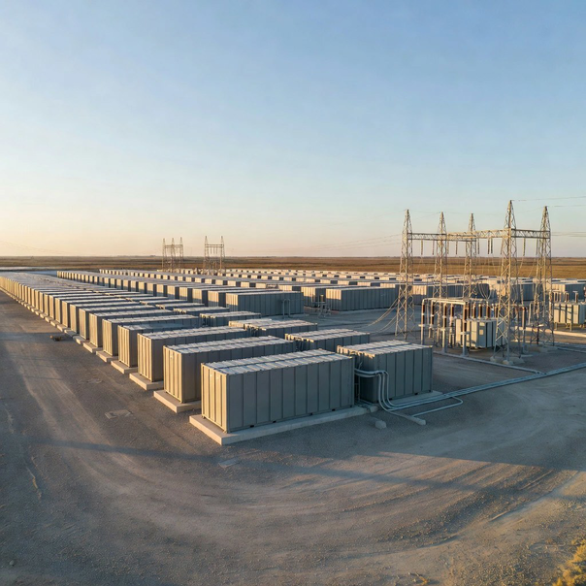
Texas holds 12.9 GW of planned battery storage additions
Absolute scale.
Texas projects account for 12.9 GW of planned utility-scale battery storage in 2026.
Resource the first market assessment around Texas.
Notes:
The 12.9 GW planned in Texas translates the 53% national share into a substantial absolute opportunity pool. This figure is nearly four times California’s planned 3.4 GW and reinforces the case for Texas-first prioritization.

Slide 10
Large named projects reinforce Texas storage concentration
• Lunis Creek BESS: 621 MW in Jackson, Texas.
• Clear Fork Creek: 600 MW in Wilson, Texas.
• Tehuacana Creek: 418 MW in Navarro County.
• Project mix: Includes solar-plus-storage developments.
Notes:
Three of the four largest battery storage projects scheduled for 2026 are located in Texas. The named projects show that the state’s concentration spans several large developments, including standalone and solar-plus-storage configurations.

Slide 11
California is the second-largest planned storage market
California projects make up 14% of planned U.S. utility-scale battery storage capacity in 2026.
Make California the second priority after Texas.
Notes:
California is planned to account for 14% of new U.S. utility-scale battery storage capacity in 2026. This is the second-largest state share behind Texas and establishes California as the primary second-wave storage market.

Slide 12
Begin with concentrated markets.
Prioritize Texas first, then California and Arizona for detailed market review.

