Slide 1
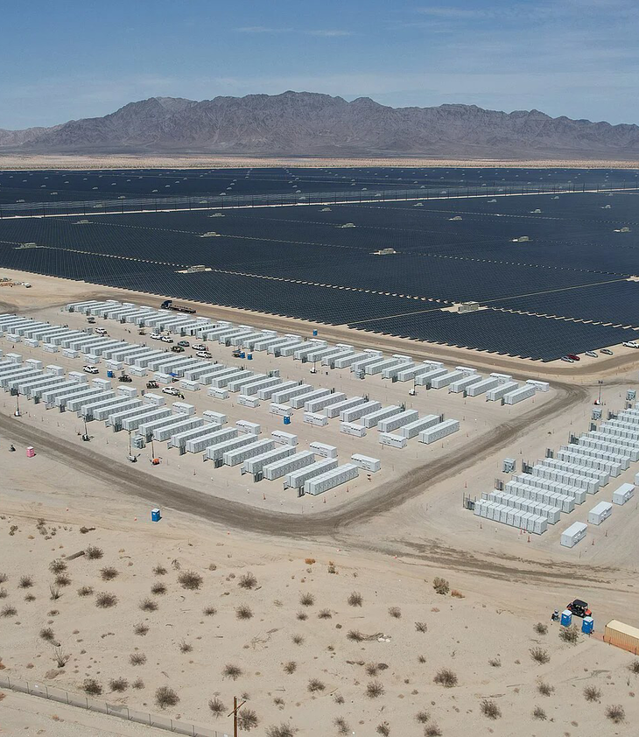
Why Grid Battery Storage Is Growing
Investor brief on U.S. utility-scale battery storage momentum.

Slide 2
Agenda
01
Installed Capacity
02
Growth Momentum
03
Planned Additions
04
Revenue Logic
Notes:
This brief focuses on the market evidence available for utility-scale battery storage in the United States. The story moves from installed capacity and growth rates to the project pipeline, the role of solar-plus-storage facilities, and the operating model that supports revenue capture.

Slide 3
U.S. Utility-Scale Storage
Nearly 52 GW
Nameplate battery capacity reached by mid-2026.
43.6 GW
Operational at end-2025.
8.3 GW
Added in first-half 2026.
Notes:
By the first six months of 2026, U.S. nameplate utility-scale battery storage capacity had reached nearly 52 GW. This followed 43.6 GW of operational capacity at the end of 2025 and 8.3 GW of additions during the first half of 2026. The current installed base makes storage a material and rapidly expanding grid asset category.

Slide 4
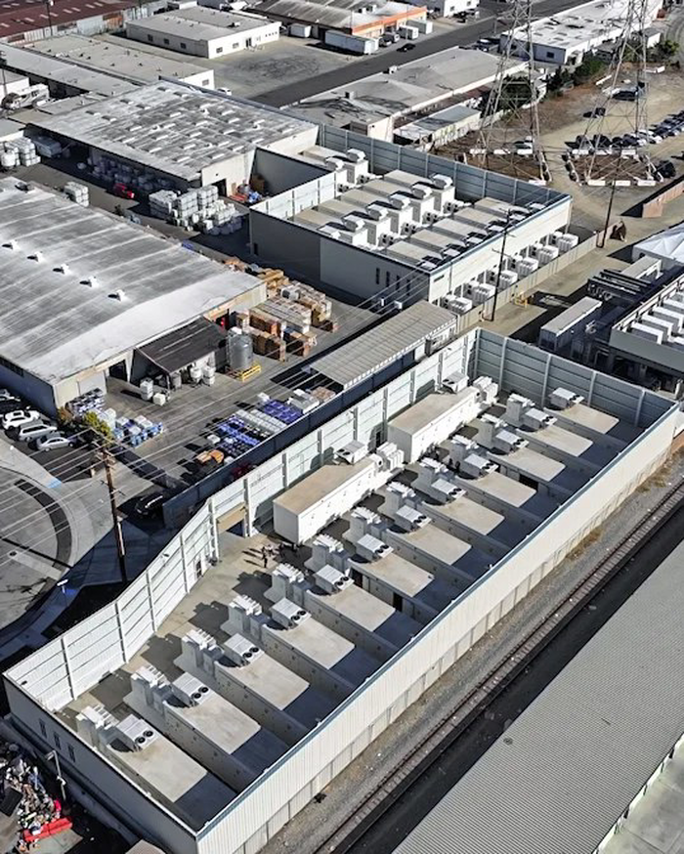
Battery Storage Averaged 70% Annual Growth
U.S. utility-scale battery storage capacity increased at a 70% annual average rate during the last three years.
Growth has moved storage into a larger grid role.
Notes:
The reported annual average growth rate over the last three years was 70%. This rate frames battery storage as one of the fastest-growing components of the utility-scale power system described in the source material. The installed base is expanding while a sizable further pipeline is planned.

Slide 5
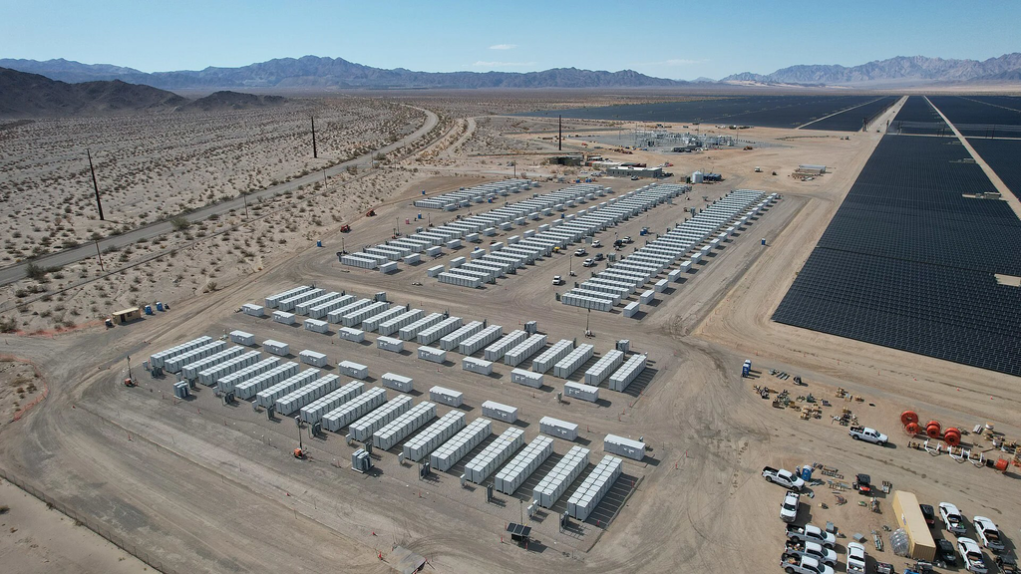
Deployment Has Built Momentum Year After Year
1
2024
10.4 GW added
Second-largest generating capacity addition after solar.
2
End-2025
43.6 GW operational
Utility-scale capacity continued expanding rapidly.
3
First-half 2026
8.3 GW added
Nameplate capacity reached nearly 52 GW.
Notes:
In 2024, operators added 10.4 GW of new battery storage capacity, the second-largest generating capacity addition after solar. By the end of 2025, the operational total was 43.6 GW. Operators then added another 8.3 GW during the first six months of 2026, bringing capacity to nearly 52 GW.

Slide 6
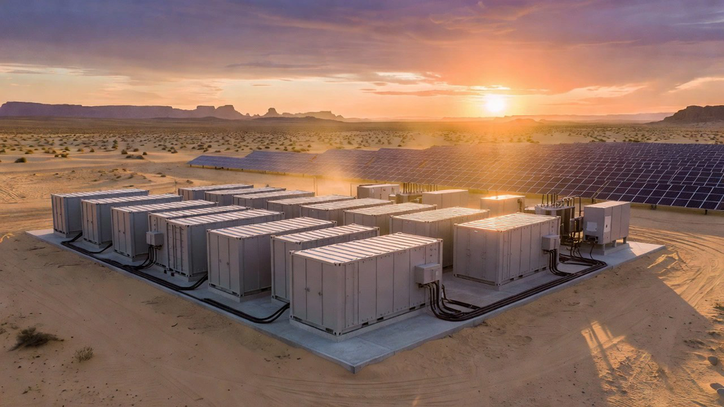
Storage Converts Price Timing Into Revenue Opportunity
1
Charge
Store electricity when wholesale prices are low.
2
Hold
Keep previously generated electricity available for later.
3
Discharge
Deliver electricity when wholesale prices are high.
Notes:
Battery storage is a secondary electricity source rather than a primary electricity source. It stores electricity that has already been created by a generator or supplied by the grid. At solar photovoltaic and storage facilities, operators can store power when wholesale prices are low and discharge it when wholesale prices are high, supporting larger profits for power producers.

Slide 7
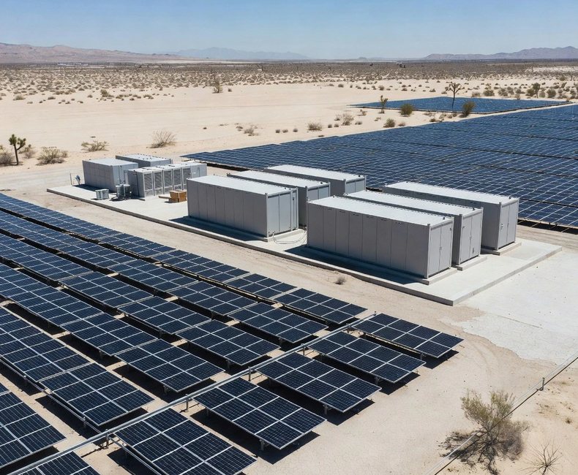
Solar Plants Host the Largest Storage Units
Integrated Infrastructure
Solar-plus-storage facilities can store lower-priced power and discharge when prices are higher.
The pairing supports greater producer profits.
Notes:
Solar photovoltaic plants host the largest battery storage capacity units described in the source material. Pairing solar and storage gives operators the ability to shift electricity from lower-price periods to higher-price periods. The largest cited facilities show that the combined configuration is already deployed at substantial scale.

Slide 8
Planned Additions Exceed the Current Installed Base
54 GW
Additional capacity planned.
Expected over the next two and a half years.
26 GW
Planned for 2027.
The largest planned annual addition.
14 GW
Planned for 2028.
Extends the deployment runway.
Notes:
Operators anticipate bringing an additional 54 GW online over the next two and a half years. Reported plans include 14 GW in the second half of 2026, 26 GW in 2027, and 14 GW in 2028. The planned pipeline is larger than the nearly 52 GW of nameplate capacity operating by mid-2026.

Slide 9
Storage Grew Fast From a Small Grid Share
2024 cumulative storage
More than 26 GW
2024 grid capacity share
2%
2024 new storage capacity
10.4 GW
2025 planned additions
19.6 GW
Notes:
The 2024 data put cumulative utility-scale battery capacity above 26 GW, representing 2% of 1,230 GW of total utility-scale electricity generating capacity. That same year brought 10.4 GW of new storage capacity. The 2025 plan reported at that time was 19.6 GW, illustrating how quickly near-term expectations were already increasing.

Slide 10
Batteries Shift Electricity Rather Than Create It
Electricity Creation
• Uses fuel or natural resources.
• Generates electricity directly.
• Acts as a primary source.
Battery Storage
• Stores previously created electricity.
• Charges from generators or grid.
• Acts as a secondary source.
Value comes from when stored electricity is delivered.
Notes:
The source material distinguishes batteries from primary electricity sources. Batteries do not create electricity from fuel or a natural resource. Instead, they store electricity already produced by generators or supplied by the grid. This storage function enables operators to manage when power is delivered rather than generating it directly.

Slide 11
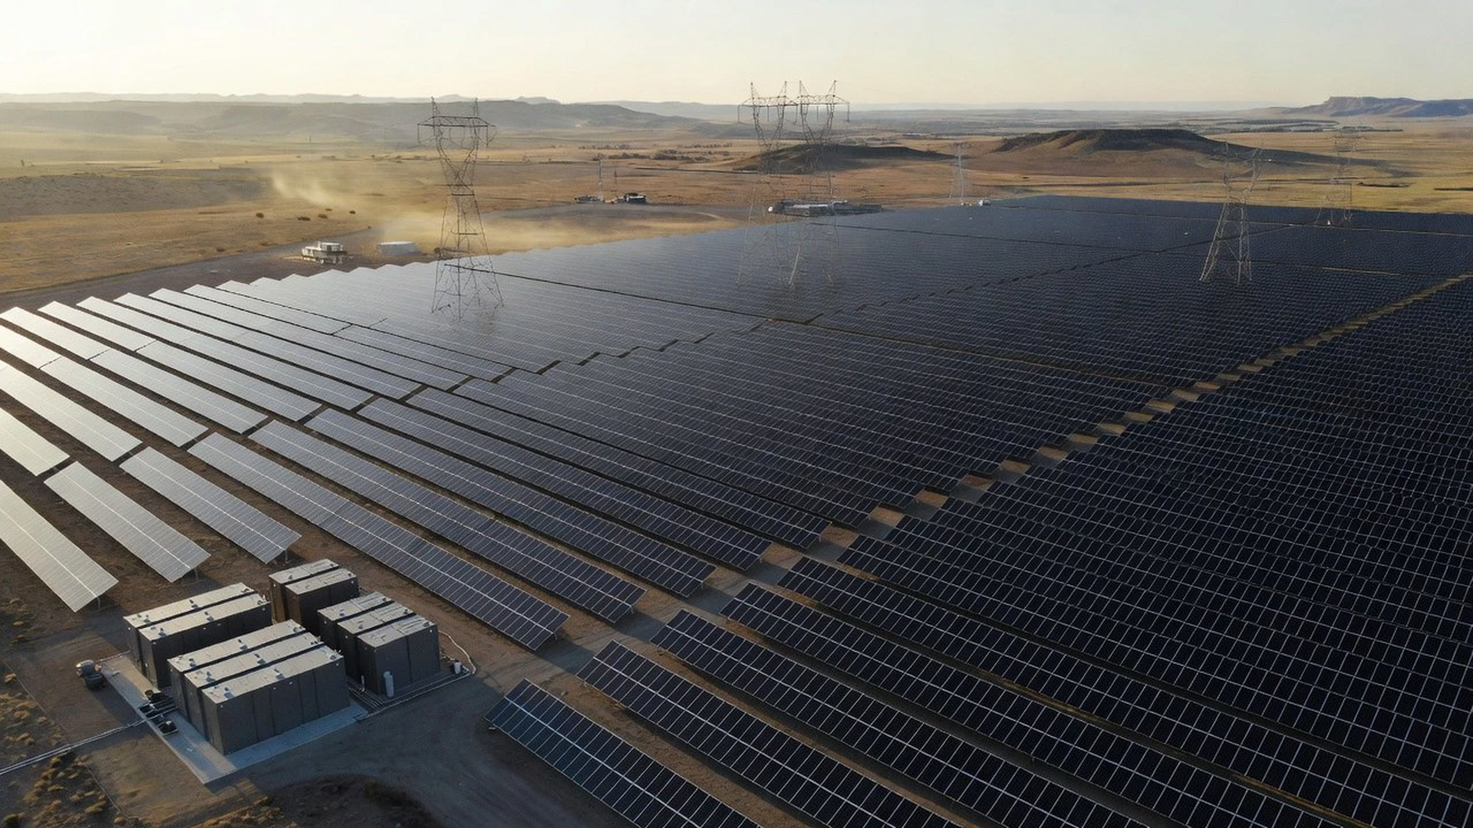
A Larger Storage Market
Capacity growth, planned additions, and price-based operating value reinforce the opportunity.
Notes:
The market case is supported by a rapidly growing installed base, a reported 70% average annual growth rate, and 54 GW of anticipated additions over the next two and a half years. Large solar-plus-storage projects demonstrate a practical operating model: storing electricity when wholesale prices are low and discharging it when prices are high.

Slide 12
Storage Momentum Is Building
Consider the expanding utility-scale battery storage opportunity.

